Slide 1
Objective 8
Two-dimensional arrays

Slide 2
ILO’s
Learning outcomes
Use two-dimensional arrays, nested iteration and constants.

Slide 3
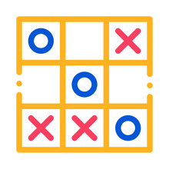
Two-dimensional arrays
Two-dimensional arrays can be used to store lots of data
These can look like data stored in a grid-like structure
What examples do you know?
Exercises:
Generate a noughts and crosses game using two-dimensional arrays
Generate a bowling game

